Slide 1
Extra C++ Pointer Practice Questions Credit: Ashley and Varick Erickson

Slide 2
Review: Key Pointer Syntax Rules and Tips
Use the reference operator & to get the memory address of a variable.
cout << &num; // prints memory address of numUse the asterisk * when declaring pointer variables
int *ptr1, *ptr2, …;
//declares two pointer variables for int type
//spacing between * and ptr doesn’t matter
You cannot mix different data types with pointers.
Using * and a pointer variable name will allow us to directly access the data the pointer is pointing at.
cout << *ptr1 << endl; //returns value ptr1 is pointing at
Using the assignment operator (=) changes the pointer’s memory address, which changes where our pointer points. This will change the memory address where the pointer points.
Using = and * together directly changes the value that our pointer is pointing to.
Use the new operator to create a new dynamic variable where a pointer points.
Draw pictures when you work with pointers, to help keep track of what is happening.
Memory address
Variable name
value

Slide 3
Pointer Practice Questions
Follow along on paper as we complete these practice questions
These questions are taken directly from past assignments and past exams.

Slide 4
Pointer Practice 1
What is the output of the following code?
int* a;
int* b;
int* c = new int;
int luckyNumber = 7;
int mysteryNumber = 10;
c = &mysteryNumber;
a = &luckyNumber;
b = a;
*b = *a + luckyNumber;
a = new int;
*a = *b + *c;
cout << "*a = " << *a << endl;
cout << "*b = " << *b << endl;
cout << "*c = " << *c << endl;
cout << mysteryNumber << endl;

Slide 5
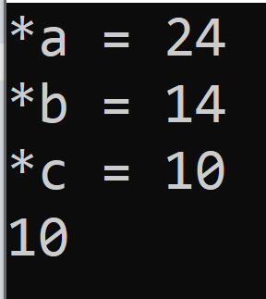
Pointer Practice 1
What is the output of the following code?
int* a;
int* b;
int* c = new int;
int luckyNumber = 7;
int mysteryNumber = 10;
c = &mysteryNumber;
a = &luckyNumber;
b = a;
*b = *a + luckyNumber;
a = new int;
*a = *b + *c;
cout << "*a = " << *a << endl;
cout << "*b = " << *b << endl;
cout << "*c = " << *c << endl;
cout << mysteryNumber << endl;

Slide 6
Pointer Practice 2
What is the output of the following code?
int* a; int* b = new int; int* c = new int; int superSecretNum = 5; a = c; c = &superSecretNum; *c = 6; *a = *c + 3; *b = 2 * superSecretNum + *a; *c = *a - superSecretNum; *a = 10; cout << "*a = " << *a << endl; cout << "*b = " << *b << endl; cout << "*c = " << *c << endl; cout << superSecretNum * 2 << endl;

Slide 7
Pointer Practice 2
What is the output of the following code?
int* a; int* b = new int; int* c = new int; int superSecretNum = 5; a = c; c = &superSecretNum; *c = 6; *a = *c + 3; *b = 2 * superSecretNum + *a; *c = *a - superSecretNum; *a = 10; cout << "*a = " << *a << endl; cout << "*b = " << *b << endl; cout << "*c = " << *c << endl; cout << superSecretNum * 2 << endl;
Answer: blank 1 = 10, blank 2 = 21, blank 3 = 3, blank 4 = 6.

Slide 8
Pointer Practice 3
int pointerMath(int x, int& y, int* z)
{
x = 5;
y = *z + x;
(*z)++;
return(x * y);
}
int main()
{
int* a = new int;
int* b = new int;
int* temp = nullptr;
int randomNumber = 5;
*a = randomNumber;
*b = 11;
temp = a;
int answer = pointerMath(*a, randomNumber, temp);
cout << answer << endl;
cout << *a << endl;
cout << *b << endl;
cout << *temp << endl;
return 0;
}

Slide 9

Pointer Practice 3 - solution
int pointerMath(int x, int& y, int* z)
{
x = 5;
y = *z + x;
(*z)++;
return(x * y);
}
int main()
{
int* a = new int;
int* b = new int;
int* temp = nullptr;
int randomNumber = 5;
*a = randomNumber;
*b = 11;
temp = a;
int answer = pointerMath(*a, randomNumber, temp);
cout << answer << endl;
cout << *a << endl;
cout << *b << endl;
cout << *temp << endl;
return 0;
}

Slide 10
Pointer Practice 4
/* * Assume the following * * a in fooA has the address 2000 * c in fooA has the address 2008 */ int fooA(int a, int& b, int* c) { b++; a += *c; cout << &a << endl; cout << b << " " << *c << " " << a << " " << c << endl; c = &a; return a - b; } /* * Assume the following * * a in main has the address 1000 * b in main has the address 1004 * c in main has the address 1000 * d in main has the address 1004 * e in main has the address 1000 * Any call to "new" will return the heap address 5000 */ int main() { int a = 5; int* b = new int(9); int c = -2; int d; int* e = &a; d = fooA(a, *b, &c); cout << a << " " << b << " " << *b << " " << c << " " << d << " " << e << " " << *e << endl; cout << &a << " " << &b << " " << &c << " " << &d << " " << &e << endl; return 0; }

Slide 11


Pointer Practice 4 Solution
/* * Assume the following * * a in fooA has the address 2000 * c in fooA has the address 2008 */ int fooA(int a, int& b, int* c) { b++; a += *c; cout << &a << endl; cout << b << " " << *c << " " << a << " " << c << endl; c = &a; return a - b; } /* * Assume the following * * a in main has the address 1000 * b in main has the address 1004 * c in main has the address 1000 * d in main has the address 1004 * e in main has the address 1000 * Any call to "new" will return the heap address 5000 */ int main() { int a = 5; int* b = new int(9); int c = -2; int d; int* e = &a; d = fooA(a, *b, &c); cout << a << " " << b << " " << *b << " " << c << " " << d << " " << e << " " << *e << endl; cout << &a << " " << &b << " " << &c << " " << &d << " " << &e << endl; return 0; }

Slide 12
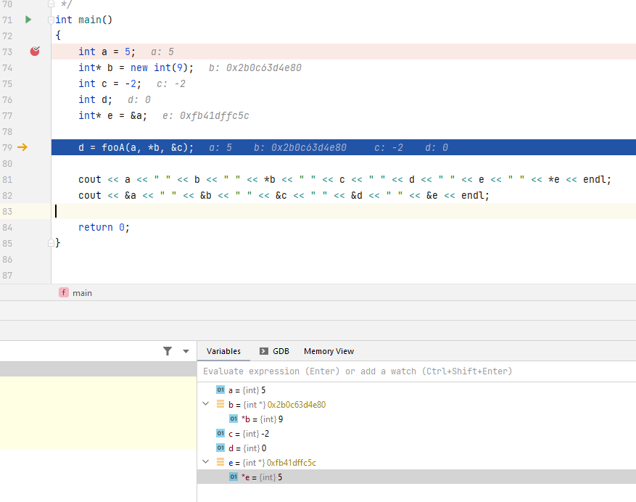

Slide 13
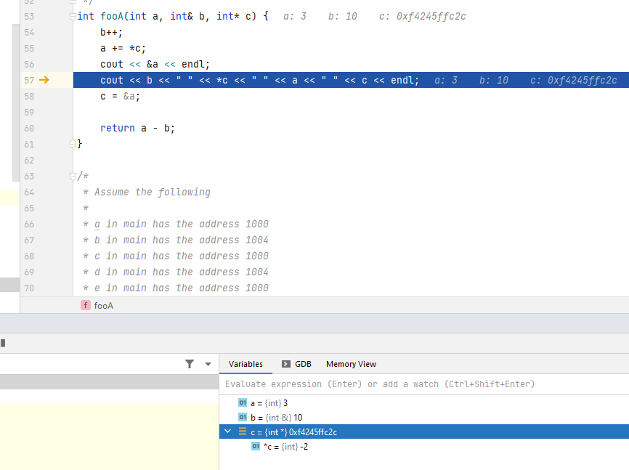
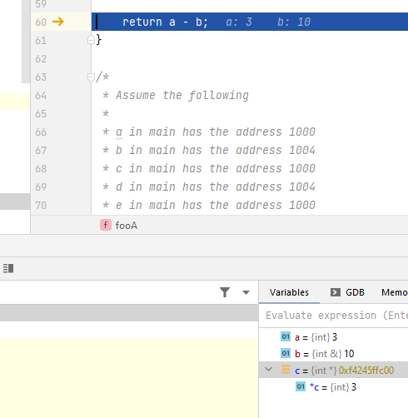

Slide 14
